Slide 1
Spoiler Alert!
April 09, 2019
Julio Soto, Mien Nguyen, Kushal Kusram, Jeremy Henry
CSCI 5593 – Advanced Computer Architecture
Department of Computer Science & Engineering

Slide 2
Agenda
Introduction
Background
Speculative Load Hazards
Spoiler Attack
Spoiler from JavaScript
Rowhammer Attack using Spoiler
Implementation Plan
Questions

Slide 3

Introduction
SPOILER – What is it?
SPeculative execution; oiler – creative addition to the name
Load
A load operation can be executed speculatively before preceding store operations. During the speculative execution of the load, false dependencies may occur due to the unavailability of physical address information. These false dependencies need to be resolved to avoid computation on invalid data.
Store Forwarding
Improve memory bottleneck
Specifically attacks the Memory Order Buffer (MOB) aka ROB
Tightly coupled with cache
Affects all Intel Core family processors – independent of OS
Core Solo (January 2006) – Core i9 (April 2018)
So what?

Slide 4
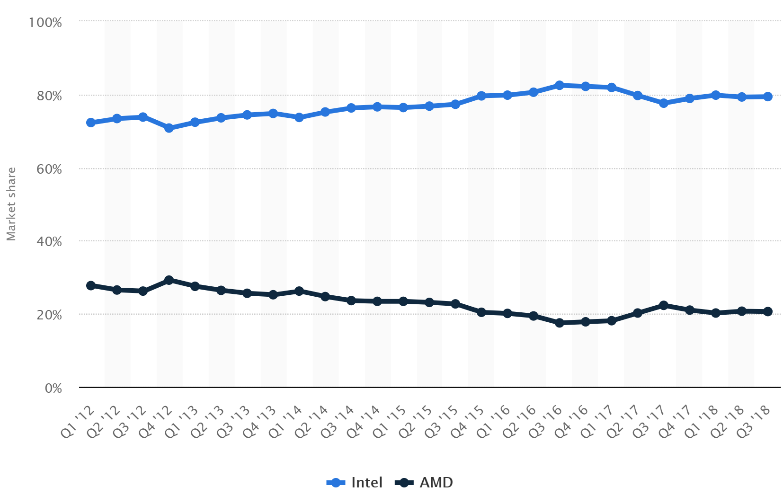
Introduction
Motivation
QTR breakdown 2012-18
x86 Processor
Intel Processors 80%
AMD 20%

Slide 5

Introduction
New
Spoiler is disclosed to Intel on December 01, 2018
Authors first to show dependency resolution logic that serves the speculative load can be exploited to gain information about the physical page mappings.
Impervious to Spectre-like mitigations
Intel:
“Intel received notice of this research, and we expect that software can be protected against such issues by employing side channel safe software development practices. This includes avoiding control flows that are dependent on the data of interest. We likewise expect that DRAM modules mitigated against Rowhammer style attacks remain protected. Protecting our customers and their data continues to be a critical priority for us and we appreciate the efforts of the security community for their ongoing research.”

Slide 6

Introduction
Intel uses a proprietary memory disambiguation and dependency resolution logic in the processors to predict and resolve false dependencies that are related to speculative load.
Intel’s dependency resolution logic suffers from an unknown false dependency independent of the 4K aliasing. The discovered false dependency happens during the 1MB aliasing of speculative memory accesses which is exploited to leak information about physical page mappings.
Why is this important?
These state-of-the-art microarchitectural attacks either rely on knowledge of physical addresses (knowledge of physical address space is only granted with root privileges) or are significantly eased by that knowledge.
Knowledge about the physical page mappings enables more attack opportunities using the Prime+Probe / Rowhammer technique.

Slide 7

Introduction
Microarchitectural side-channel attacks, such as Rowhammer and cache attacks, rely on the reverse engineering of the virtual-to-physical address mapping.
Spoiler exploits leakage to speed up the reverse engineering by a factor of 256 (Rowhammer), & 4096 (using the Prime+Probe attack), even using sandboxed environments like JavaScript.
Spoiler improves Rowhammer attacks by conducting DRAM row conflicts deterministically with up to 100% success
double-sided Rowhammer attack with normal user’s privilege; due to the possibility of detecting contiguous memory pages using Spoiler leakage.

Slide 8

Introduction
Comparable Work
Spectre attacks: exploit vulnerabilities in the speculative branch prediction unit. Attacks imply that side channels, such as caches, can be used as a primitive for more advanced attacks on speculative engines.
Speculative branch prediction suffers from the security weakness where an adversary can fool the predictor and introduce arbitrary mispredictions that leave microarchitectural footprints in the pipeline that can be collected through the cache side channel to steal secrets.
Speculative engines predict the outcome of an operation before its completion, and they enable execution of the following dependent instructions ahead of time based on the prediction.
Speculative Store Bypass (SSB) vulnerability: a variant of the Spectre attack
relies on the stale sensitive data in registers to be used as an address for speculative loads which may then allow the attacker to read this sensitive data.

Slide 9

Introduction
Comparable Work
Meltdown & Foreshadow
Exploit the transient execution of instructions after a fault and can leak memory content of protected environments
MemJam
Exploits the 4K aliasing false dependency, after read-after-write, in Intel processors to perform a side-channel attack.
First uses page offset for initial guess, and secondly performs the final resolution based on the exact physical address.
Second stage has sub-stages where the address resolution logic performs additional partial address checks that lead this attack being observable/detectable.
SPOILER is NOT like any of these comparable works

Slide 10



Introduction
Applicability
What it could be used for?
Glean data from cache to exploit physical address mapping
Access data
Entirely subvert the OS memory isolation to read the memory content from more privileged security domains, and bypass defense mechanisms such as Kernel Address Space Layout Randomization (KASLR)
JUN 2017
JAN 2018
OCT 2018
DEC 2018
JAN 2024?

Slide 11
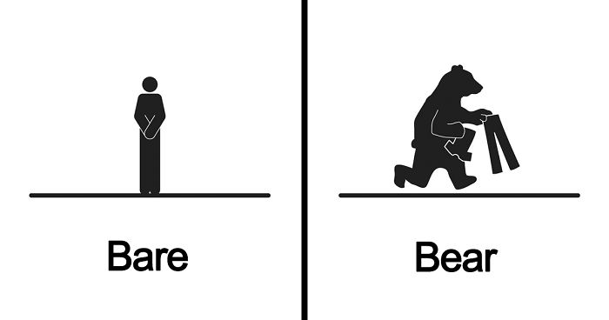
Introduction
CPUs
Affected
Intel - proprietary memory disambiguation and dependency resolution logic suffers from an unknown false dependency independent of the 4K aliasing happening during the 1MB aliasing of the speculative memory access.
Not affected
ARM
AMD
“We are aware of the report of a new security exploit called SPOILER which can gain access to partial address information during load operations. We believe that our products are not susceptible to this issue because of our unique processor architecture. The SPOILER exploit can gain access to partial address information above address bit 11 during load operations. We believe that our products are not susceptible to this issue because AMD processors do not use partial address matches above address bit 11 when resolving load conflicts.”

Slide 12

Introduction
Is there a problem?
Potential of data being gleaned from…
PC
Databases
Solution…?
Securing the Intel Core processors from vulnerabilities that may be able to be exploited.

Slide 13
Background
Mien Nguyen

Slide 14
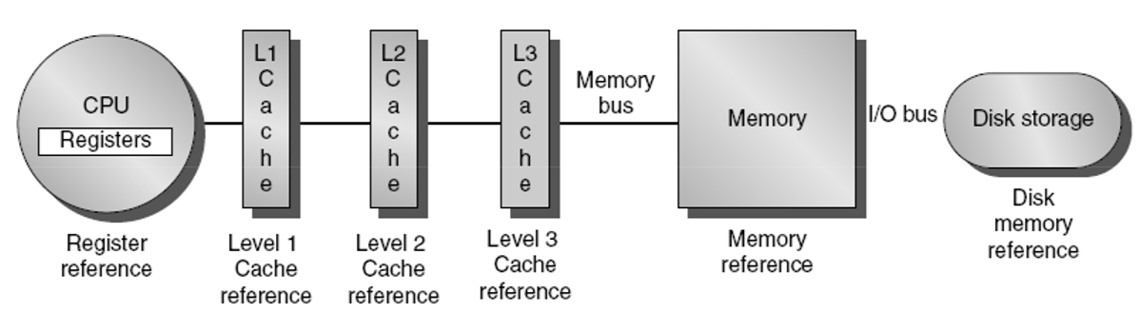
Background
Prime + Probe attack
Rowhammer attack
SPOILER boosts/facilitates/motivates Rowhammer and Prime + Probe attack

Slide 15
Background – Memory Management
Program
Virtual Address Space
Translation
From VA -> PA
RAM
Physical Address Space
Processor
Ld R3, 1024(R0)
Ld R2, 512(R0)
Add R1, R2, R3
Map
Data for R3
VA | PA
512 | 12
786 | disk
1024 | 2
VA 1024
PA 2

Slide 16
Background – Memory Management
Program
Virtual Address Space
Translation
From VA -> PA
RAM
Physical Address Space
Processor
Ld R3, 1024(R0)
Ld R2, 512(R0)
Add R1, R2, R3
Map
Data for R3
VA | PA
512 | 12
786 | disk
1024 | 2
VA 1024
PA 2
Note: 32 bits machine (32 bits VA) 256kb RAM (28 bits PA), 4kB page (12 bits page offset)
Map
VA | PA
0x00512 | 0x0012
0x00786 | disk
0x01024 | 0x0002
Virtual page #
Page offset
Physical page #
Page offset
20 bits | 12 bits
16 bits | 12 bits
0x01024204
0x0002204

Slide 17
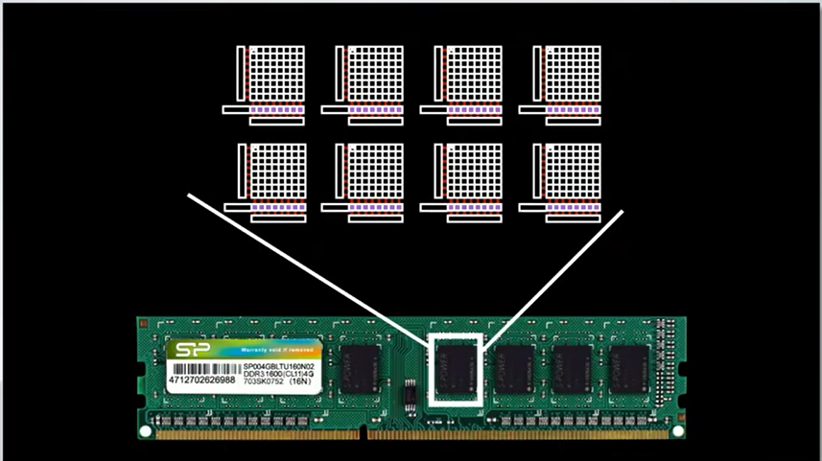
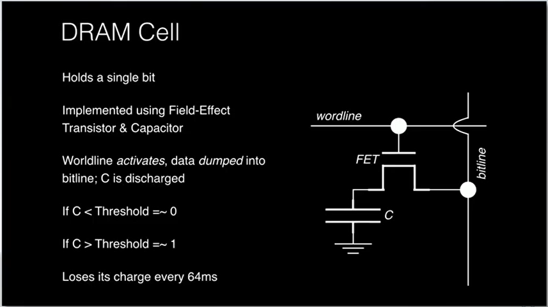
Background – DRAM
Background – DRAM
Consumer wants smaller, faster, cheaper DRAM
The size of DRAM has been decreased significantly over years (In 2000, Intel DRAM size was 500Megabit/cm2 - 1Gigabit/cm2. As of now, DRAM size is around 16Gigabit/cm2)
The cell becomes closer and closer
It's harder for manufacturer to electrical seal cells from each other
This causes charge leaking
Each chip holds 8-16 banks
Each bank holds million cells in it

Slide 18
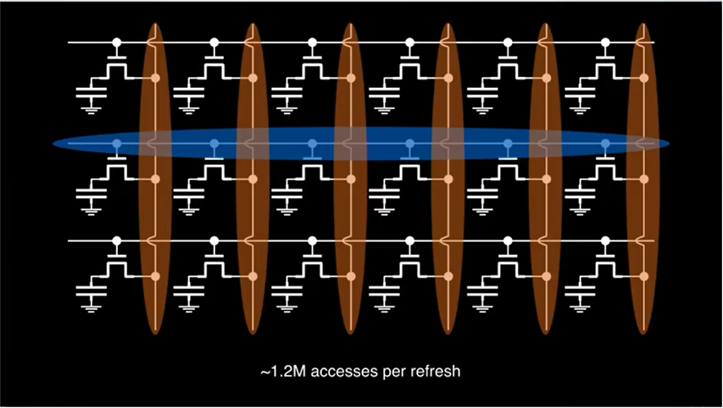
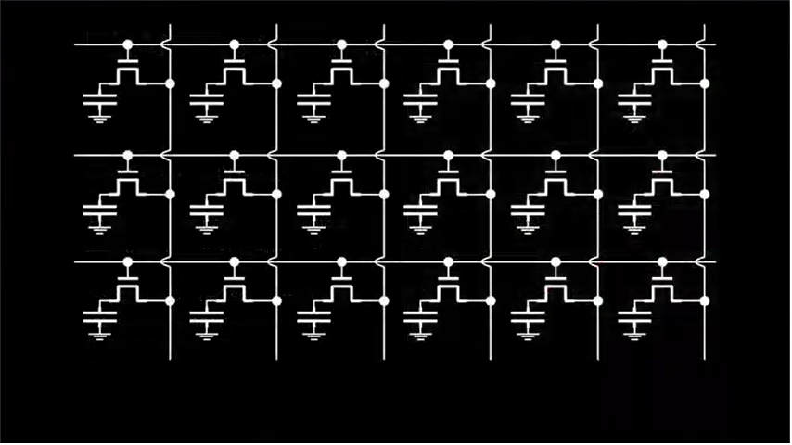
Background – Rowhammer

Slide 19
Background – Rowhammer

Slide 20
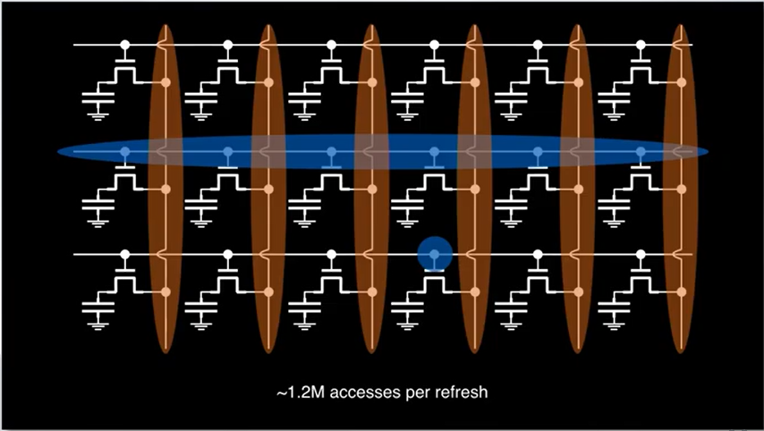
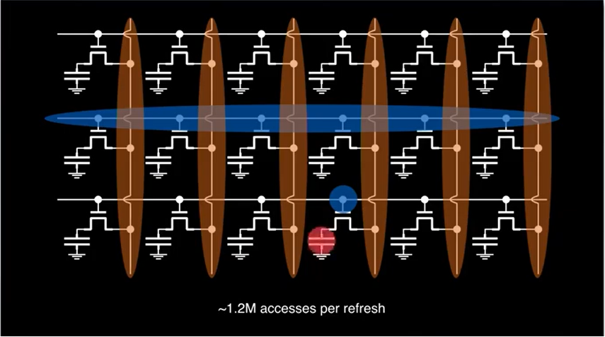
Background – Rowhammer
If the program hammers (hits) the row continuously before it gets refresh, a charge from the line could accidently leak to the transistor below, cause the Capacitor flip (Bit flip) from 0 -> 1, or 1->0

Slide 21
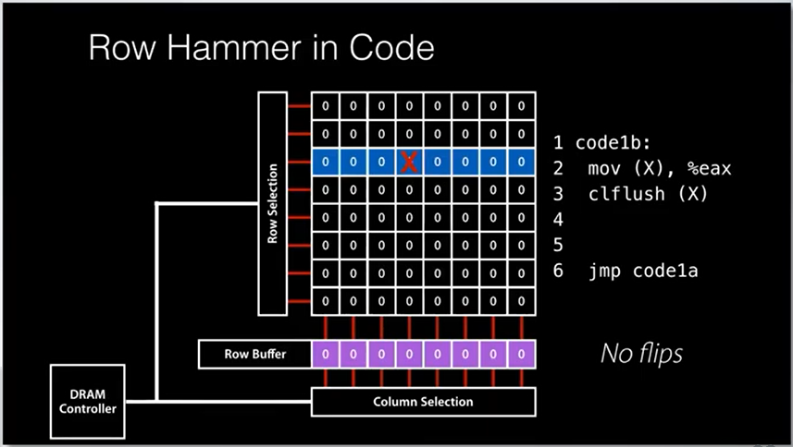
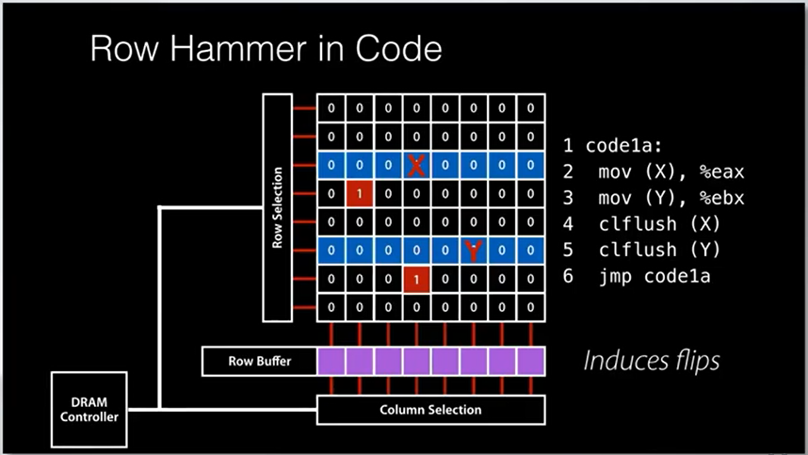
Background – Rowhammer
However...

Slide 22
Rowhammer and Spoiler relationship
Rowhammer requirement: Access to DRAM rows that are adjacent to a victim row.
Question: How can a program read the rows in the same bank of DRAM and those rows need to be adjacent?
Answer: There are some technique to detect the ADJACENT rows in the SAME bank (Ex: Bare Metal Access, Unprivileged Access). Within scope of this project, we introduce Spoiler, which satisfies Rowhammer requirement above (facilitates/enables Rowhammer to happen). Please see the "Rowhammer using Spoiler"
Rowhammer consequence: If you can figure out the physical page layout, you can make a better guess about what bits you might like to flip in the page table to make a R/O page R/W or to map a physical page you shouldn't see into your address space.
If one of the bits you're able to flip happens to be bits in a page table, and enough stars line up, allows you to flip the 'access' bits on pages you're interested in, the MMU will let you read them as you will.
Rowhammer consequence and Spoiler relationship: Spoiler leaks physical page layout, which satisfies Rowhammer consequence above (motivates Rowhammer to happen).

Slide 23
The Spoiler Attack
Kushal Kusram

Slide 24

Speculative Load Hazards – We know!
Out-of-Order Execution – Speculative behavior
False Dependency
Unsolved True Dependency
ACA Quiz

Slide 25
Speculative Load Hazards - Resolution
Dependency Check Logic
Loosenet Hit?
Finenet Hit?
Physical Address Match?
Redispatch Load
Yes
No
No
No
Partial Physical Addr Hit?
No
No
No
Loosenet: Page offsets of load and store compared.
Finenet: Checks upper virtual address bits, or the physical address tag.
Physical Address Matching: Full physical address checked.
Proceed with Load
Block Load/
Forward Store
Yes
Yes
‘load’ checked against all preceding ‘store’ to ensure correctness
Notes:
Page offset is identical between VA and PA, loosenet can be performed as soon as store is decoded. Dependency resolution may fail to resolve dependency.

Slide 26
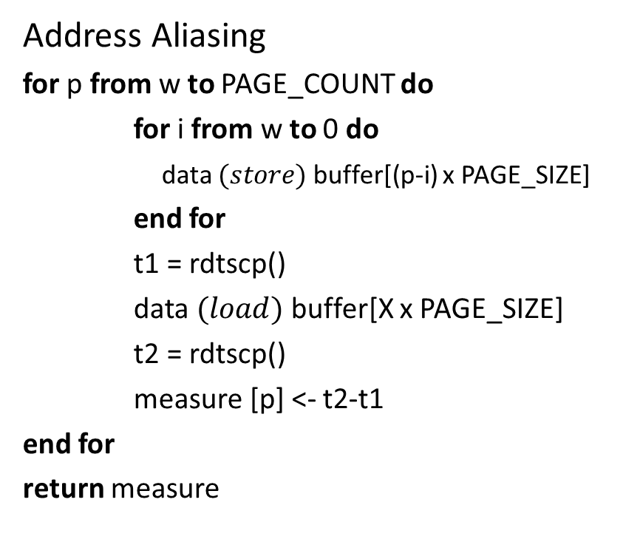
The Spoiler Attack - Technical
Address Aliasing
for p from w to PAGE_COUNT do
for i from w to 0 do
data $(store)$buffer[(p-i) x PAGE_SIZE]
end for
t1 = rdtscp()
data $(load)$ buffer[X x PAGE_SIZE]
t2 = rdtscp()
measure [p] <- t2-t1
end for
return measure
Timing Measurement of Speculative Load
rdtscp;
mov %eax, %esi;
mov (%rbx), %eax;
rdtscp;
mfence;
sub %esi, %eax;
Read Time-Stamp Counter and Processor ID
Performs serializing operation on all preceding load/store instructions
HPC: Hardware Performance Counters, keep a track of low-level hardware-related events in the CPU, accessed via special purpose registers.
PAPI: Performance API
Notes:
Algotirhm: executes a speculative load after multiple stores and make sure that 4K aliasing is caused dutring execution of the load. With w as the window size, algo iterates over a numbe of different memory pages and for each page performs stores to that page and all previousw pages within a window. W=64. Making sure max. no of entries are made in store buffer and hence maxium potential conflicts.

Slide 27
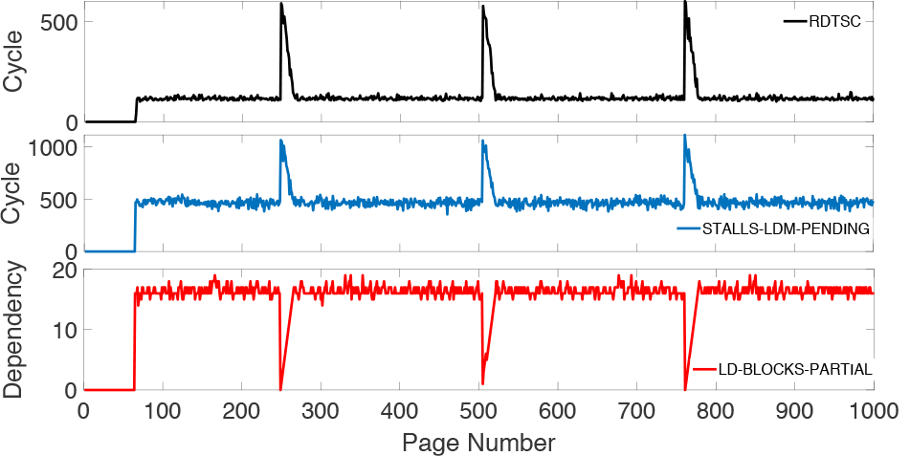
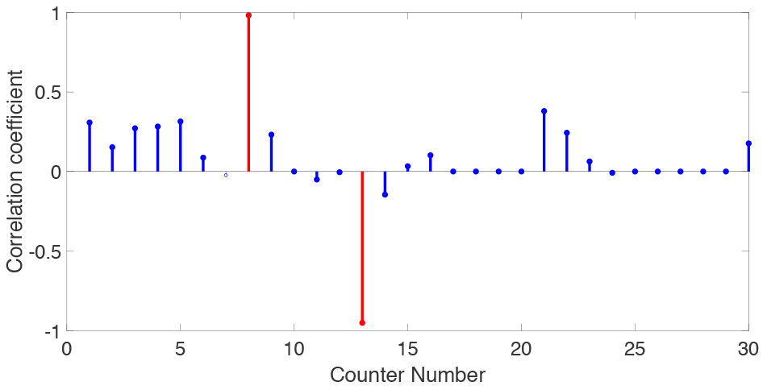
Speculative Dependency Analysis
Procedure
Execute Algorithm on 1000 pages
PAPI, monitor 30 different HPCs
Each HPCs monitored
Cycle_Activity: Stalls_Ldm_Pending
HPC value & ‘load’ time recorded
Compare HPCs and Timing for correlation
Ld_Blocks_Partial: Address_Alias
Identify events to support leakage

Slide 28
Leakage of Physical Address Mapping
Observe the pagemap file – any relation with latency?
Cycle_Activity: Stalls_Ldm_Pending Remember?
The above verifies latency due to pending load
Yes, 20 LSB of PA for load match with PA for store at peaks
Therefore, aliasing exists in physical address space
Alas! 8 bits of mapping unknown to user space was just revealed

Slide 29

The Spoiler Attack – Eagle View

Slide 30

The Spoiler Attack – Eagle View
VA = PA
JavaScript
Virtual Address
Physical Address
malicious program
Perform Spoiler Attack
If
VA = PA?
PA revealed to user program
Physical Memory

Slide 31
Spoiler from JavaScript
Jeremy Henry

Slide 32
Spoiler from JavaScript
High impact
Attacks can be accomplished remotely or without any privileges
Victim unknowingly downloads malicious code embedded in the script

Slide 33
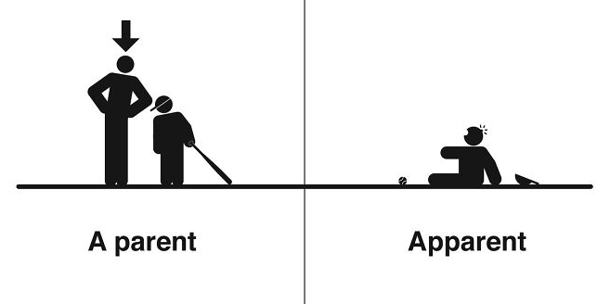
Spoiler from JavaScript
Side-channel attacks inside a browser can be performed efficiently using WebAssembly
Virtual machine used to support multi-language apps
Designed to run alongside JavaScript
Emulates a 32-bit environment

Slide 34
Spoiler from JavaScript
Spoiler can penetrate the abstraction layer
Replace 'rdtscp' measurement with a timer (SharedArrayBuffer)
Aliased addresses can be exposed and be used for speeding up eviction set creation

Slide 35
Eviction Sets
Collection of virtual addresses that are all mapped to a specific cache set
Eviction sets enable an adversary to
Replace contents from the specified cache set
Bring specific cache sets into a controlled state
Probe whether this state has been modified by the victim

Slide 36
Eviction Sets
Existing algorithm for eviction set creation used
Tested with Intel Core i7 4770 with four physical cores and a shared 8MB 16-way L3 cache
80% accuracy rate to find 8192 eviction sets from a pool of 4096 pages.
Process takes an average of 46s

Slide 37
Evaluation
Using Spoiler, eviction set search sped up drastically
Only need to use aliased addresses
One of 2⁸ is an aliased address instead of 2²⁰
Provides speedup of 4096
Algorithm | Repetitions | Success | Avg Time
Classic | 3 | 80% | 46s
AA | 10 | 67% | 10s
AA | 20 | 100% | 12s

Slide 38
Rowhammer attack using Spoiler
Rowhammer requires access to DRAM rows ADJACENT to a victim row.
Double-sided Rowhammer attack: The attacker tries to access two different rows n+1 an n−1 to induce bit ﬂips in the row n placed between them. Doubled-sided further requires access to contiguous memory pages.
Single-sided Rowhammer attack: The attacker needs to make sure that multiple virtual pages co-locate on the same bank.

Slide 39
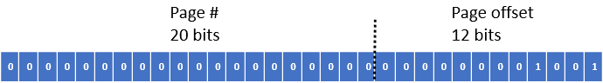
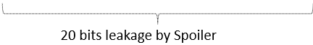
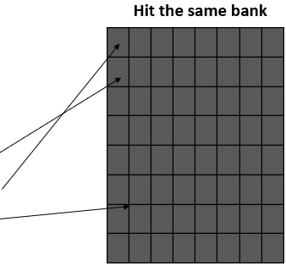
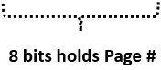
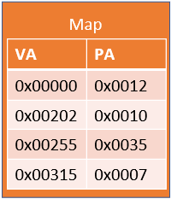
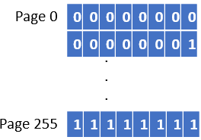
Single-sided Rowhammer - DRAM Bank Co-location
32 bits Virtual Address

Slide 40
Single-sided Rowhammer - DRAM Bank Co-location
Summary
For single-sided Rowhammer, use SPOILER to detect aliased virtual memory addresses where the 20 LSBs of the physical addresses match. The memory controller uses these bits for mapping the physical addresses to the DRAM banks.
Whenever the number of physical address bits used by the memory controller to map data to physical memory is equal to or less than 20, we always hit the same bank. For each additional bit the memory controller uses, the probability of hitting the same bank is divided by 2 as there is one more bit of entropy. In general, we can formulate that our probability p to hit the same bank is p = 1/2n, where n is the number of unknown physical address bits in the mapping.
Use SPOILER to detect aliased virtual memory addresses where the 20 LSBs of the physical addresses match. The memory controller uses these bits for mapping the physical addresses to the DRAM banks.
To verify if our aliased virtual addresses co-locate on the same bank, we use the row-conﬂict side channel as proposed in [11] (timings in the appendix, Section 10.2). We observe that whenever the number of physical address bits used by the memory controller to map data to physical memory is equal to or less than 20, we always hit the same bank. For each additional bit the memory controller uses, the probability of hitting the same bank is divided by 2 as there is one more bit of entropy. In general, we can formulate that our probability p to hit the same bank is p = 1/2n, where n is the number of unknown physical address bits in the mapping.

Slide 41
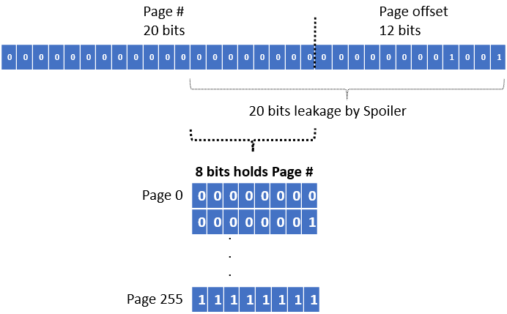
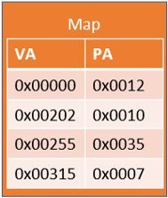
Double-sided Rowhammer - Contiguous Memory
​ | ​ | ​ | ​ | ​ | ​ | ​ | ​
​ | ​ | ​ | ​ | ​ | ​ | ​ | ​
​ | ​ | ​ | ​ | ​ | ​ | ​ | ​
​ | ​ | ​x | ​ | ​ | ​ | ​ | ​
​ | ​ | ​ | ​ | ​ | ​ | ​ | ​
​ | ​ | ​ | ​ | ​ | ​ | ​ | ​
​ | ​ | ​ | ​ | ​ | ​ | ​ | ​
​ | ​ | ​ | ​ | ​ | ​ | ​ | ​

Slide 42
Double-sided Rowhammer - Contiguous Memory
Summary
For a double-sided Rowhammer attack, attacker needs to hammer rows adjacent to the victim row in the same bank. Since the rows are generally placed sequentically within the banks, access the adjacents row within the same bank can be archieved if we have access to contiguous physical pages.
The paper shows that an attacker can use SPOILER to detect contiguous memory using 1 MB aliasing peaks.

Slide 43
Implementation Plan
Access vHPCs
Linux
Timing
Record Latency
Obtain VA
Access ‘pagemap’
Obtain PA
Match with VA
Coorelation to vHPCs
PAPI Library
Run Algorithm
Algorithm Implementation
Using C++
Uses PAPI Library
Ubuntu

Slide 44
Reference
Saad, Moghimi, Ahmad, Bruhns, Ida, Krebbel, Moritz, Berk, Eisenbarth, Thomas, and Berk, “SPOILER: Speculative Load Hazards Boost Rowhammer and Cache Attacks,” [astro-ph/0005112] A Determination of the Hubble Constant from Cepheid Distances and a Model of the Local Peculiar Velocity Field, 01-Mar-2019. [Online]. Available: https://arxiv.org/abs/1903.00446. [Accessed: 08-Mar-2019].
Y. Kim, R. Daly, J. Kim, C. Fallin, J. H. Lee, D. Lee, C. Wilkerson, K. Lai, O. Mutlu, Carnegie Mellon University, and Intel Labs, “Flipping Bits in Memory Without Accessing Them: An Experimental Study of DRAM Disturbance Errors,” IEEE Xplore Digital Library, 14-Jul-2014. [Online]. Available: https://ieeexplore.ieee.org/document/6853210. [Accessed: 04-Apr-2019].
L. Tung, “All Intel chips open to new Spoiler non-Spectre attack: Don't expect a quick fix,” ZDNet, 05-Mar-2019. [Online]. Available: https://www.zdnet.com/article/all-intel-chips-open-to-new-spoiler-non-spectre-attack-dont-expect-a-quick-fix/. [Accessed: 28-Mar-2019].
“SPOILER,” AMD . [Online]. Available: https://www.amd.com/en/support/kb/faq/pa-240. [Accessed: 28-Mar-2019].
“Distribution of AMD and Intel x86 computer processors worldwide, from 2012 to 2018, by quarter,” statista. [Online]. Available: https://www.statista.com/statistics/735904/worldwide-x86-intel-amd-market-share/. [Accessed: 05-Apr-2019].

Slide 45
Questions?

Slide 46
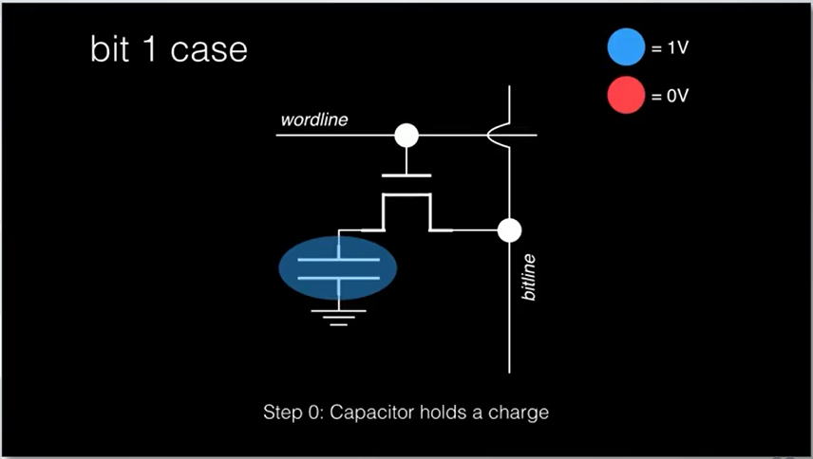
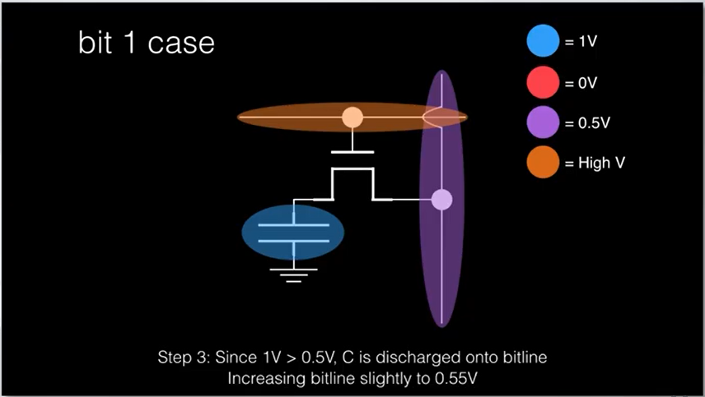
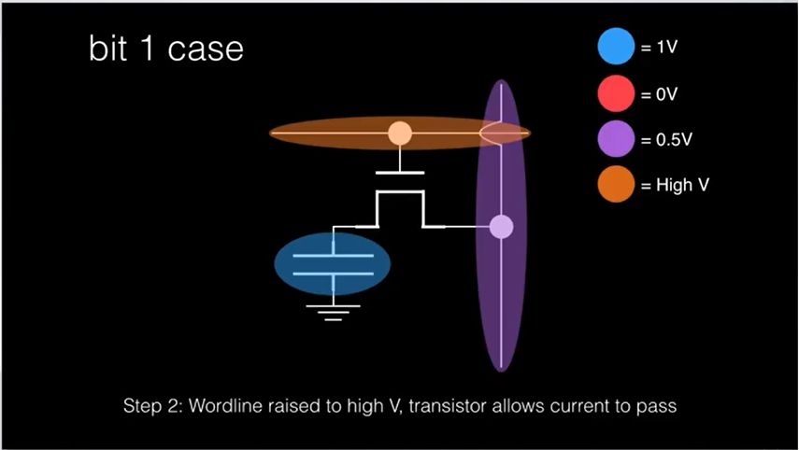
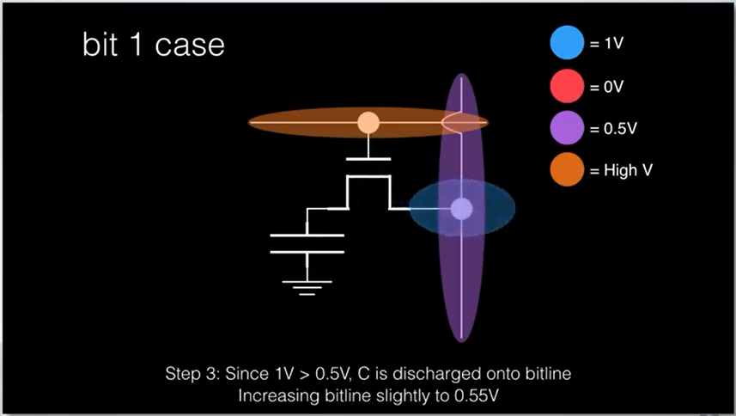
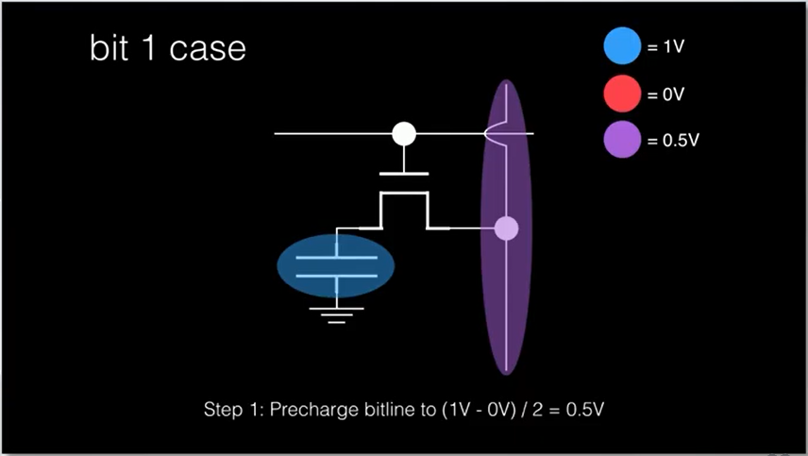
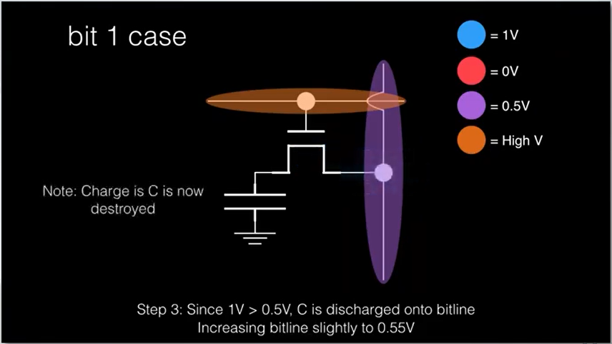
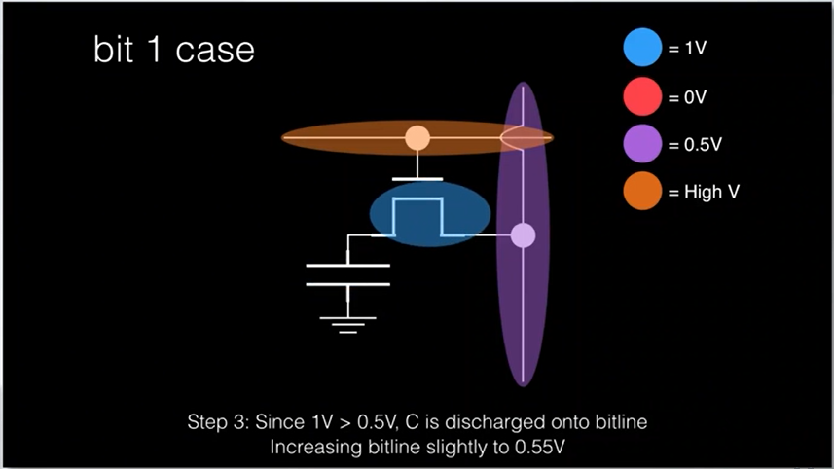
Appendix – Rowhammer

Slide 47
Tracking Speculative Loads with SPOILER
Single threaded attacks
Steal information before/after the attacker code on the same thread
Scenarios
I) Context switches between processes of difference users
II) between a user process and a kernel thread
III) Intel Software Guard eXtensions (SGX) secure enclaves
Observes microarchitectural state after the victim’s exection.

Slide 48
Tracking Speculative Loads with SPOILER
Proposed attack methodology
1) Adversary fills the store buffer with arbitrary address
2) Issues the victim context switch and lets the victim perform a secret-dependent memory access
3) Measures the execution time of the victim
Correlations between victims’ timing and load address can leak secrets
Victim should access the memory while there are aliased addresses in the store buffer (if the stores are committed before the victim’s speculative load, there will be no dependency resolution hazard)

Slide 49
Mitigations
Software
Remove timers from browsers
Hardware
Modify design for memory disambiguator to prevent physical address leakage
Performance impacts
Difficult to be applied to legacy systems and could take years to be deployed

